Slide 1
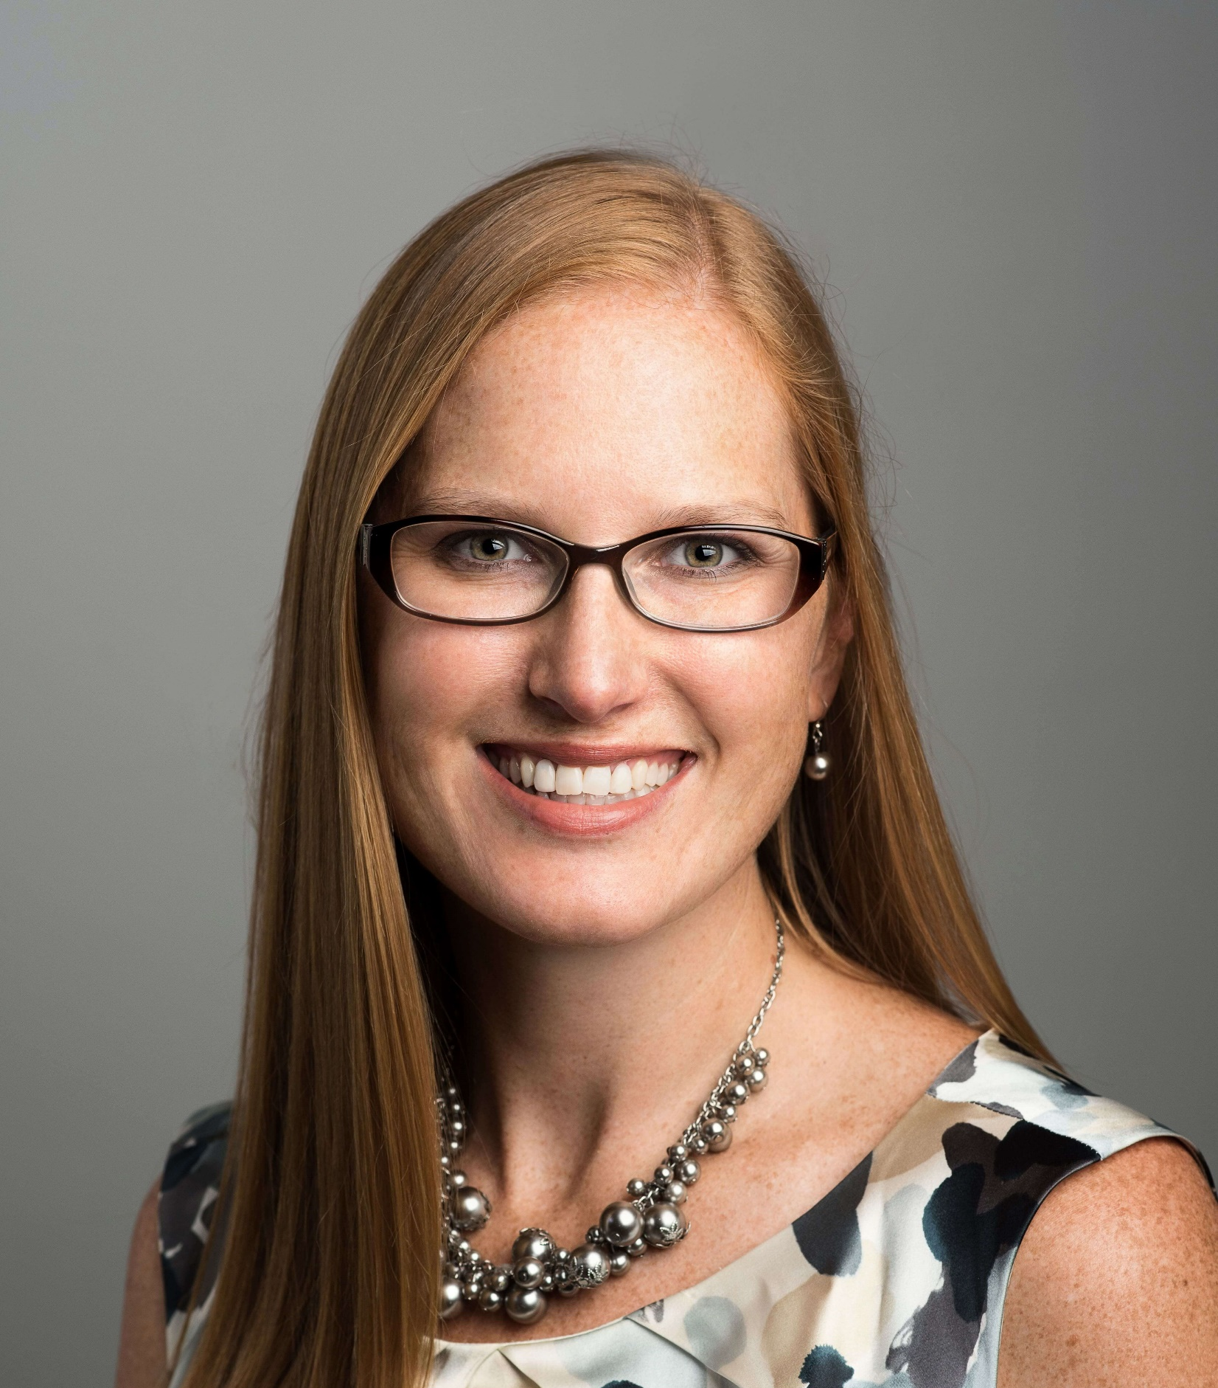
Meet Our School Counselor
Mrs. Odrzywolski (Mrs. “O”)

Slide 2
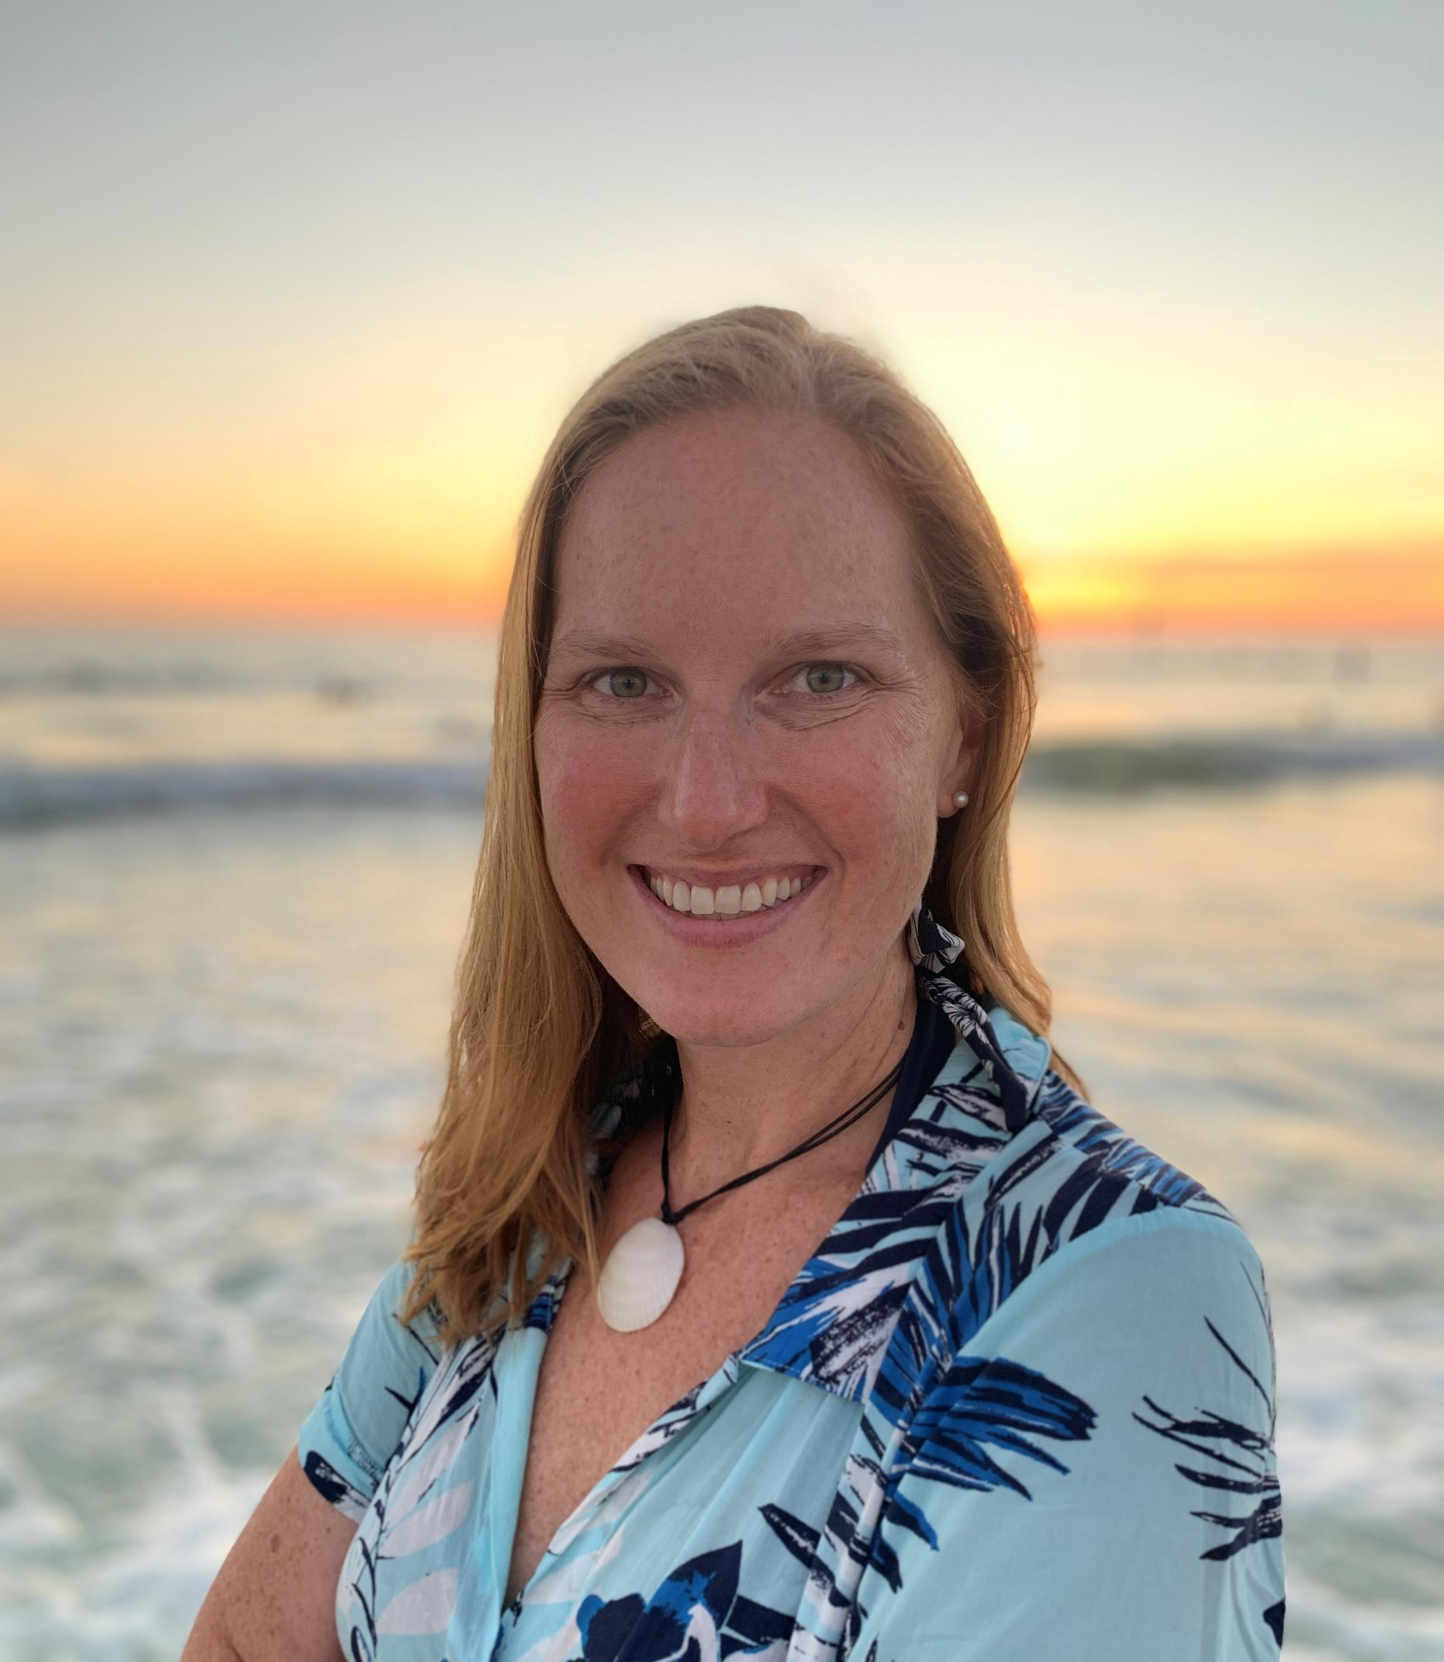
About Mrs. O
I have a bachelor’s degree in Psychology from the State University of New York, College at Fredonia and a Master’s degree in School Counseling from the University at Buffalo, State University of New York.
I moved to Florida from western New York (near Buffalo/Niagara Falls) with my husband and two boys.
I love to kayak (especially near manatees!), run, bike, and be outside. I enjoy spending time with my family, especially when we’re playing at the beach!

Slide 3
What does a School Counselor do?
Classroom Lessons
Counseling Services
Responsive Services

Slide 4
Classroom Lessons
Regular classroom instruction is provided to students by school counselors and is reinforced by teachers.
THE SCHOOL ENVIRONMENT
To become familiar with facilities and procedures
To learn more about the school counseling program and the role of the school counselor
SELF AND OTHERS
To understand characteristics, abilities and interests
To recognize and respect the feelings, needs and uniqueness of others
ATTITUDES AND BEHAVIORS
To understand how feelings and behaviors are related to consequences
To learn how behavior can be changed, if desired
DECISION-MAKING AND PROBLEM SOLVING
To understand the decision-making and problem-solving process
To know when and how to ask for help
CAREER AWARENESS
To gain skills that will later be used in the workplace (cooperation, following directions, meeting deadlines)
To understand and value the world of work
To understand the correlation between interests, abilities and occupations

Slide 5
Counseling Services
Students who need additional support outside of the classroom setting may participate in individual or group counseling sessions with the school counselor. Some of the more common issues taken up in counseling include:
PERSONAL/SOCIAL SKILLS
How to interact with peers How to appropriately express feelings
Coping with change Improving communication skills
ACADEMIC SKILLS
Developing a positive attitude about school and learning
Setting goals and priorities
Increasing study and test-taking skills while reducing test-taking anxiety
MUTLICULTURAL and GLOBAL CITIZENSHIP
To appreciate one’s home, school and community and to be a positive contributing member of one’s environment
How to manage anger How to resolve conflict Building self-esteem Dealing with grief and loss (including divorce and separation)

Slide 6
Responsive Services
Teacher Consultation
The school counselor assists and consults with teachers in areas such as: response to intervention, guidance related activities, group dynamics, behavior management, conflict resolution, crisis intervention, student assistance team efforts, special school-wide activities, and special committees.
Parent Consultation
The school counselor is available to all parents of our students. Some of the areas in which we may work together are: new student orientation, home school relations, helping students achieve success academically, personally, socially and in a future career, self-esteem building, parenting issues, dealing with crisis, referrals to community agencies.

Slide 7
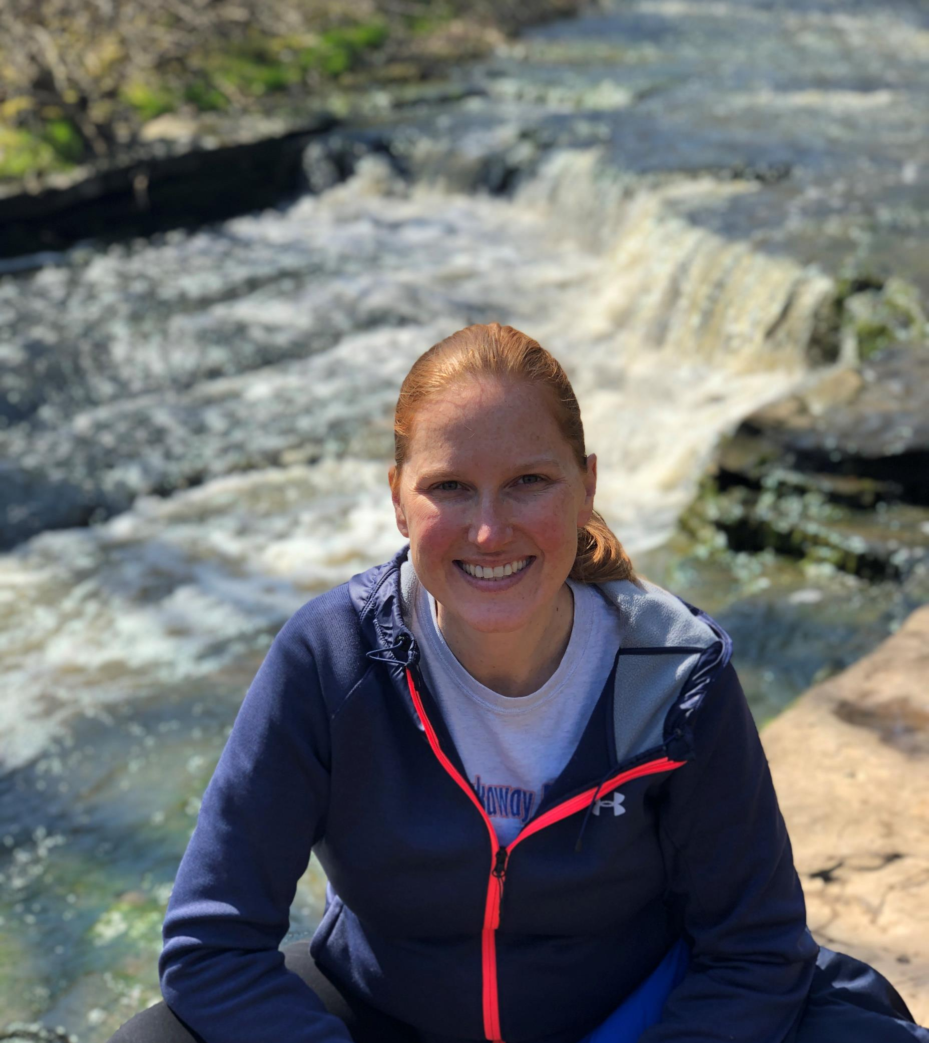
Contact Information:
Mrs. Odrzywolski
School Counselor
(727) 547-7853 x 2060
odrzywolskim@pcsb.org

